Slide 1


Chapter 7
Graphics on HTML5 canvas

Slide 2
Learning objectives
1. How to work with canvas
2. How to draw various shapes
3. How to display some of the graphical gadgets
4. How to draw graphs
5. How to create an icon for the app on the home screen
6. How to run an app locally with no Internet connection

Slide 3
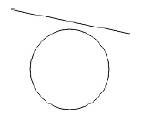
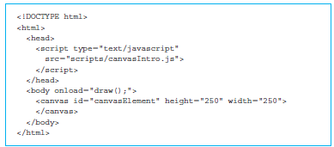
Introduction to canvas drawing
The body contains the canvas element where we will be drawing a line and a circle.

Slide 4
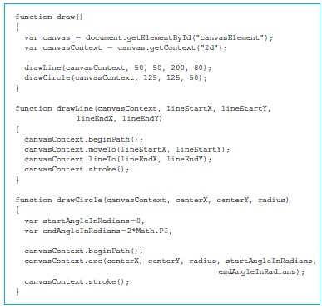
Introduction to canvas drawing (cont’d)
Retrieve the canvas using the getElementByID() method, employing the “canvasElement” as the id.
drawLine() function
drawCircle() function

Slide 5
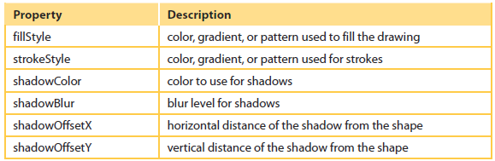
Frequently used methods and properties of the canvas element
www.w3schools.com

Slide 6
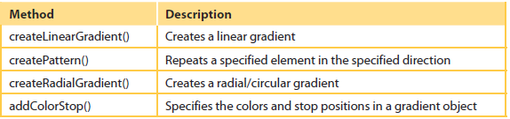
Methods related to setting colors, styles, and shadows of a canvas element

Slide 7
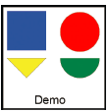
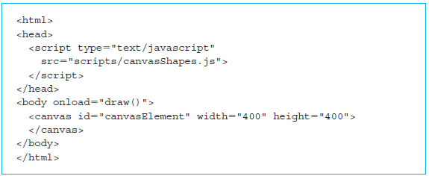
canvasShapes app

Slide 8
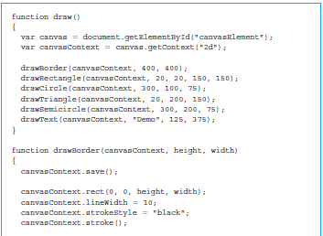
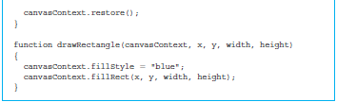
canvasShapes app (cont’d)
Retrieve the canvas using the getElementByID() method employing the “canvasElement” as the id.
The drawBorder() function receives three parameters: the canvas context element and the height and width of the canvas.

Slide 9
canvasShapes app (cont’d)
All the shapes are going to be filled with different colors.
The first line of each of these functions starts by setting up the appropriate color for the property fillStyle.
One additional common feature for all the shapes is the fact that the drawing is enclosed in the pair beginPath() and closePath().
This ensures these functions signal to the canvas that everything drawn between those two functions should be connected together.
drawCircle(): receive the x and y coordinates of the center and the radius.

Slide 10
canvasShapes app (cont’d)
drawTriangle() method receives the x and y coordinates of the starting point and length of the triangle.
Use the moveTo() method to move to the starting point.
The first line of the triangle is a horizontal line of the given length.
Add the length to the x coordinate of the starting point while keeping the y coordinate to be the same as the starting point resulting in the call: canvasContext.lineTo(startX+length, startY).
drawSemiCircle() function

Slide 11
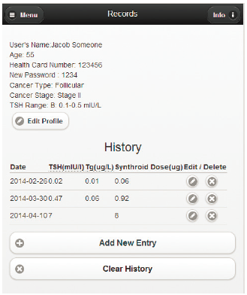
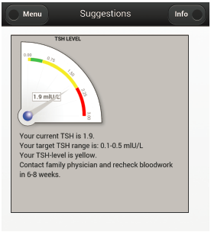
Adding advice and gauge meter to the Thyroid app using RGraph
Let us refresh our memory of where we were in the Thyroid app.
<div> section with id “pageAdvice”.

Slide 12
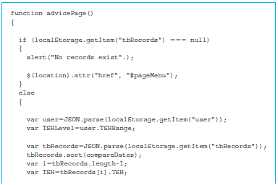
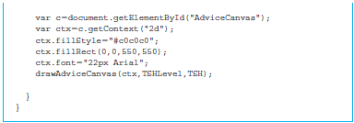
Adding advice and gauge meter to the Thyroid app using RGraph (cont’d)
The function advicePage() checks to make sure that the localStorage has an item with the name “tbRecords”.

Slide 13
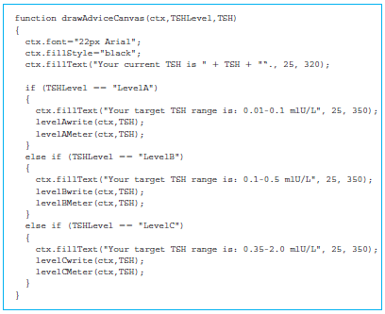
The function drawAdviceCanvas()
Set the font and fillStyle for the text and write the current value of TSH in the x coordinate 25 and row 320.
Depending on the TSH range, use an if/else conditional statement to first write the acceptable TSH range.

Slide 14
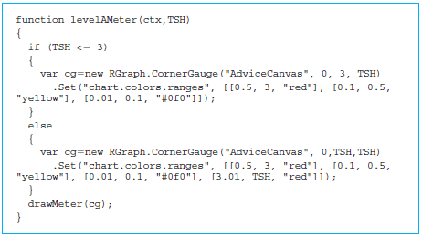
The JavaScript code for levelAMeter(), levelBMeter(), and levelCMeter()
Rgraph: a free HTML5 canvas-based JavaScript library.
Downloaded from http://www.rgraph.net

Slide 15
The JavaScript code for levelAMeter(), levelBMeter(), and levelCMeter() (cont’d)
The statements inside both the if and else parts are the same.
Create the CornerGauge meter from the RGraph library using the constructor RGraph.CornerGuage().
The constructor takes four parameters:
1. The id of the canvas that will hold the gauge meter (“AdviceCanvas”)
2. The lower bound of the value (0 in both cases)
3. The upper bound of the value (3 if TSH is less than or equal to 3; otherwise the same as TSH)
4. The value that will be displayed by the meter

Slide 16
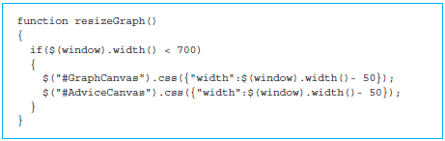
resize() function
It makes sure that our graphs fit properly on smaller devices.
The function looks at the width of the window using $(window).width.
If the width is less than 700, we need to make adjustments to the canvases in our app.
The adjustment is done using the css() method of the canvas element.
The css method allows us to dynamically set the display properties of the HTML5 elements.

Slide 17
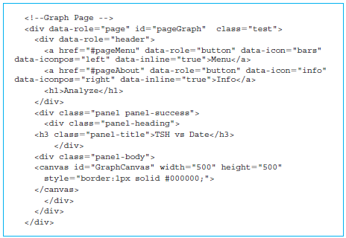
Drawing line graphs in the Thyroid app using RGraph
Canvas with id “GraphCanvas”. This canvas will be used to render the graph.
This rendering is done by the JavaScript function drawGraph(), which is listed in the file GraphAnimate.js.

Slide 18
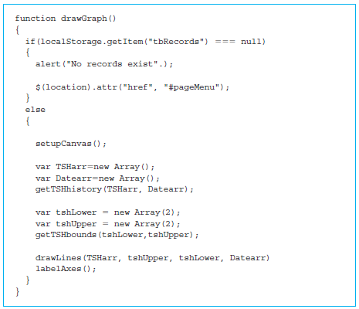
Drawing line graphs in the Thyroid app using RGraph (cont’d)
The function drawGraph() checks to make sure that the localStorage has an item with the name “tbRecords”.
If the item does not exist, an appropriate dialogue box is displayed using the alert() method, and control is returned to the pageMenu.

Slide 19
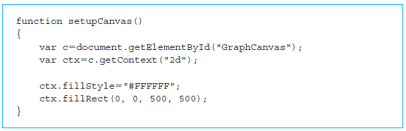
Drawing line graphs in the Thyroid app using RGraph (cont’d)
Code for setting up the canvas is shown below, which includes getting the canvas element using the id, then its context.
The fillStyle is set to white (hexadecimal value FFFFFF), and a rectangle of 500 by 500 is filled using the fillRect() method.

Slide 20
Drawing line graphs in the Thyroid app using RGraph (cont’d)
The function drawLines() creates a line chart from the RGraph library using the constructor RGraph.Line().
The constructor takes a minimum of two parameters.
The first parameter is the id of the canvas (“GraphCanvas”).
The subsequent parameters are the arrays that contain the values that will be plotted.
1. Array of TSH values from the test results.
2. Upper bound of the TSH—an array with two elements that have the same value that gives us the horizontal line.
3. Lower bound of the TSH—an array with two elements that have the same value that gives us the horizontal line.

Slide 21
Drawing line graphs in the Thyroid app using RGraph (cont’d)
“labels” specifies an array that will be used to display values on the x-axis.
“colors” is used to specify line colors.
chart.labels.ingraph is an array of labels drawn inside the chart. We have just chosen to label the third point. The array can consist of
∘ The label text (“TSH”)
∘ The text color (“blue”)
∘ The background color (“yellow”)
∘ Position value: 1 or -1 to denote whether the label should be above or below the line
∘ The length of the label pointer (80)

Slide 22
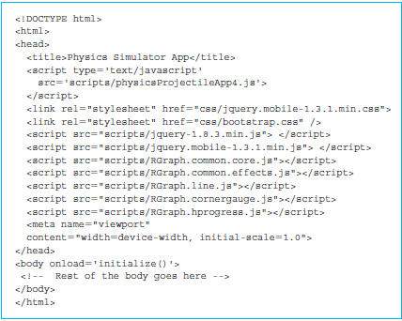
Drawing line graphs in the Thyroid app using RGraph (cont’d)
Possible to recycle code from different apps.
Added RGraph scripts to draw the graph and bootstrap CSS to include a panel.

Slide 23
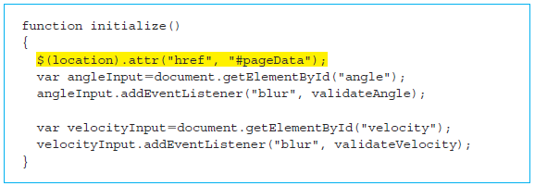
Making the output of the Projectile app graphical using RGraph
Onload attribute for the <body> element.
$(location).attr("href", "#pageData");

Slide 24
Previously discussed functions
update(), which is specified as the onclick attribute value for the calculate button on the data page.
calcDistance() to calculate distance traveled by the projectile using the horizontal distance traveled based on the horizontal component of the velocity and time.
calcHeight() to calculate height reached by the projectile using the horizontal distance traveled based on the vertical component of the velocity and time.

Slide 25
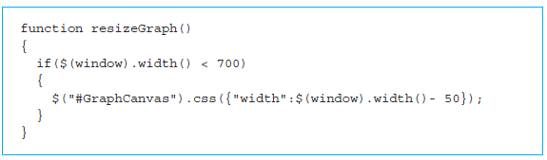
resizeGraph() function
The resizeGraph() function adjusts the graphs for smaller screens.

Slide 26
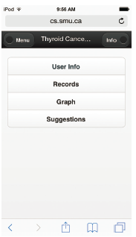
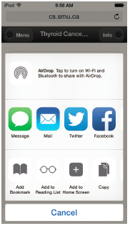
Creating an icon on the home screen
Create an icon on the home screen of our device so that we do not have to connect to the Internet to view the app.
The icon will launch the default browser and load our app with a single tap.

Slide 27
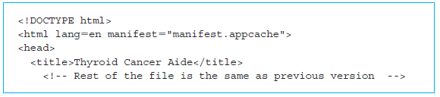
Running an app locally without the Internet
Should be able to access the HTML5 app even when we are not connected to the Internet—that is, store the app locally on our device.
Should be able to make the app full screen without browser controls such as navigation buttons and URL address box.
In order for the device to be able to run the HTML5 page locally, we need to add a manifest file to the website.

Slide 28
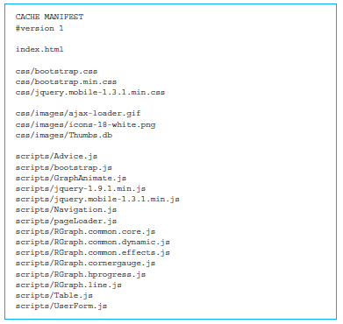
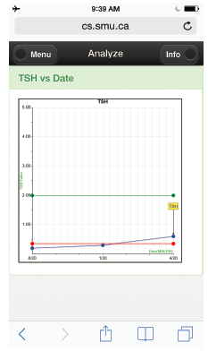
manifest.appcache file

Slide 29
Quick facts/buzzwords
getContext()
beginPath()
closePath()
moveTo()
lineTo()
arc()
stroke()
fill()
rect()
strokeRect()
fillRect()
fillText()

Slide 30
Quick facts/buzzwords (cont’d)
RGraph
CornerGauge
Line
cache
manifest

